Slide 1
Mobile App – For iOS and Android Devices

Slide 2
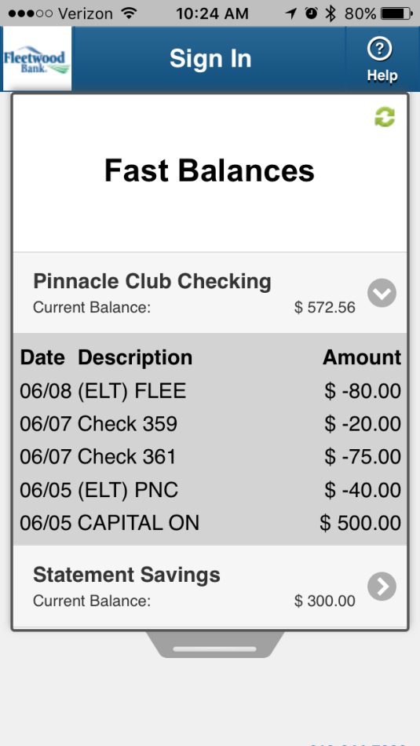
Fast Balances
Up-to-date account balances are available without having to log in
Shows the last five transactions for each registered account
Set up/disable Fast Balances in the app service center

Slide 3
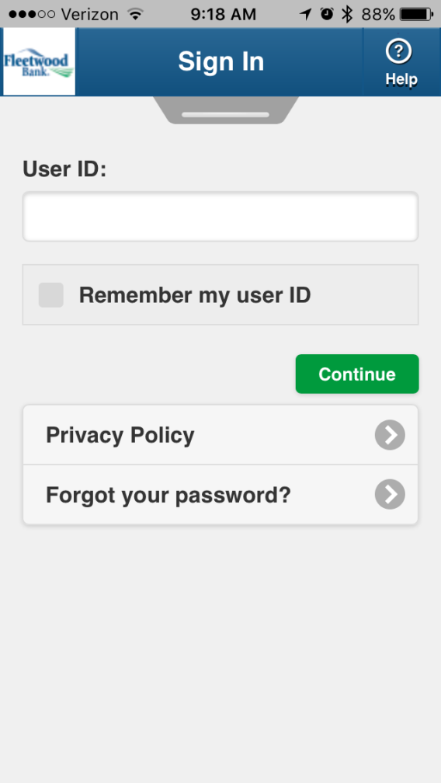
Sign In Page
Sign In credentials are not stored on the device
Links for the company’s privacy policy, enrollment details, etc.
Dedicated help button in the navigation bar

Slide 4
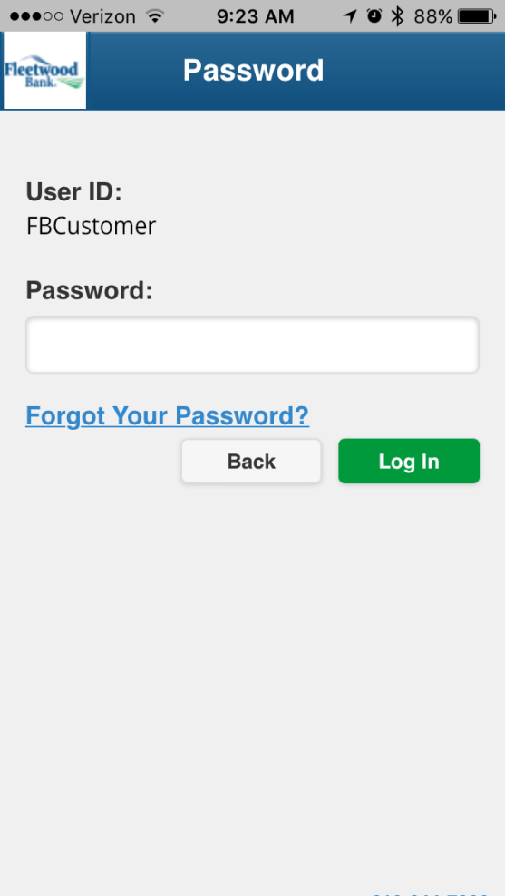
Password Page
Sign In credentials are not stored on the device
The password is hidden/masked as you type
Additional links for FAQs, company policies, and password reset features

Slide 5
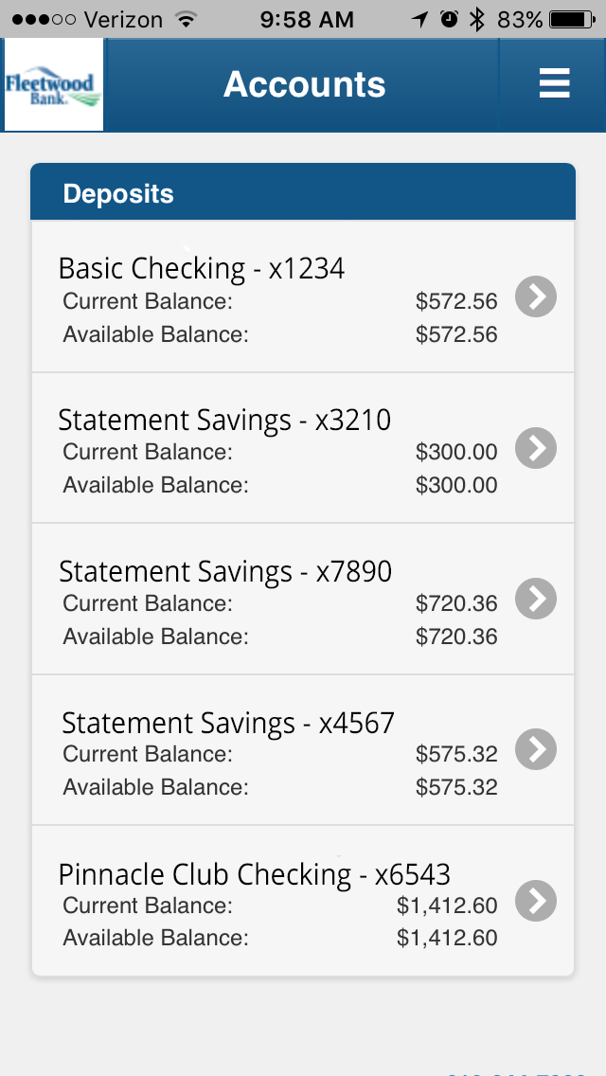
Accounts Page
Quick overview of all user accounts
Includes the current and available balances at any time

Slide 6
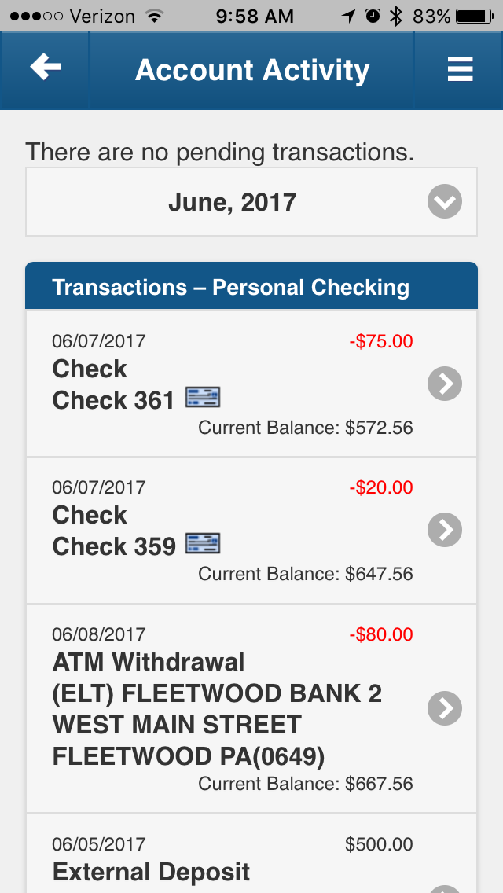
Account Activity Page
Details the latest transactions at any time
Filter transactions by month

Slide 7
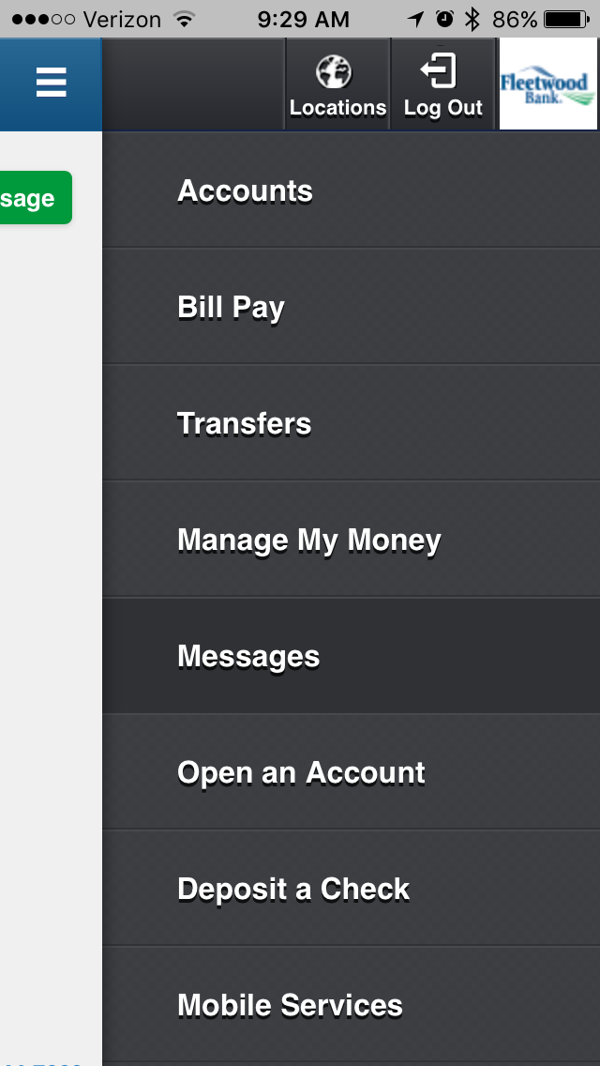
App Navigation
Navigate easily using the slide-out menu
The navigation menu is available from all app pages by sliding to the left or pressing the menu button in the upper-right corner of the app

Slide 8
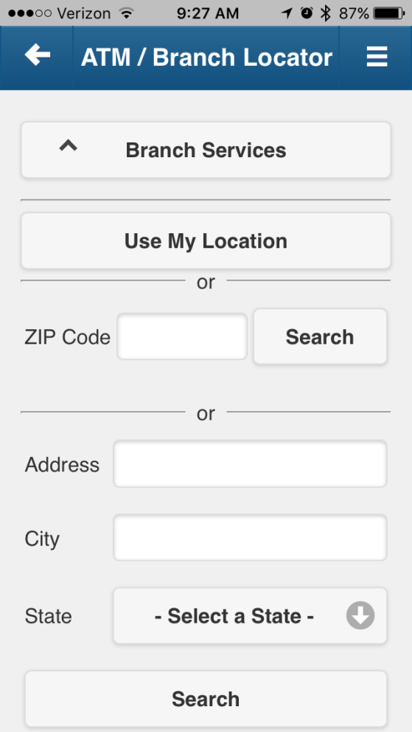
ATM / Branch Locator
Use the mobile device’s GPS to find the nearest branch location
Filter results by type of branch
Search by address or zip code
Locations are displayed clearly on a map
Get turn-by-turn directions from the results

Slide 9
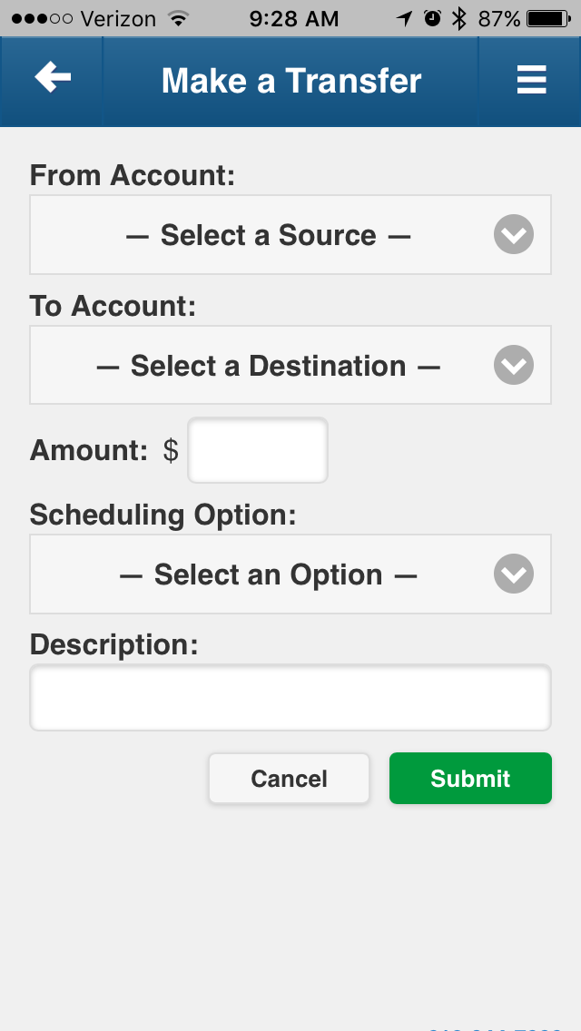
Bank Transfers
Transfer source and destination are selectable
Can select Immediate, Future-Dated, or Recurring transfers from within the mobile app
View all currently scheduled transactions

Slide 10
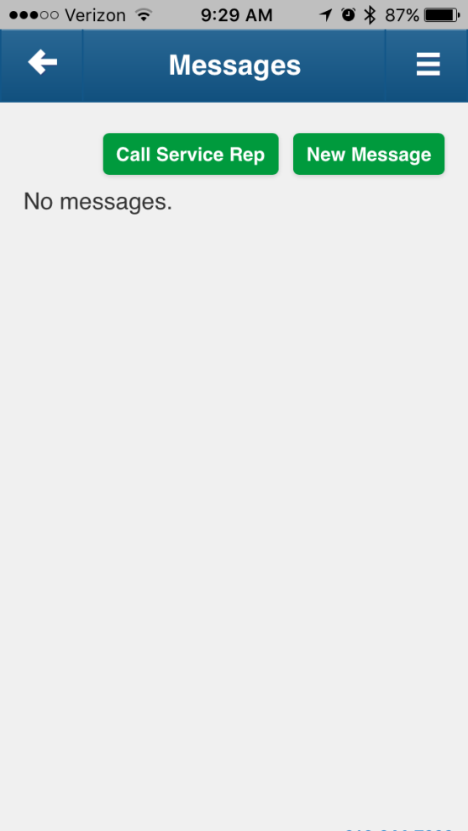
Message Center
Receive notification emails directly on your mobile device
Respond to the financial institution directly from message center.
Call directly from the mobile app

Slide 11
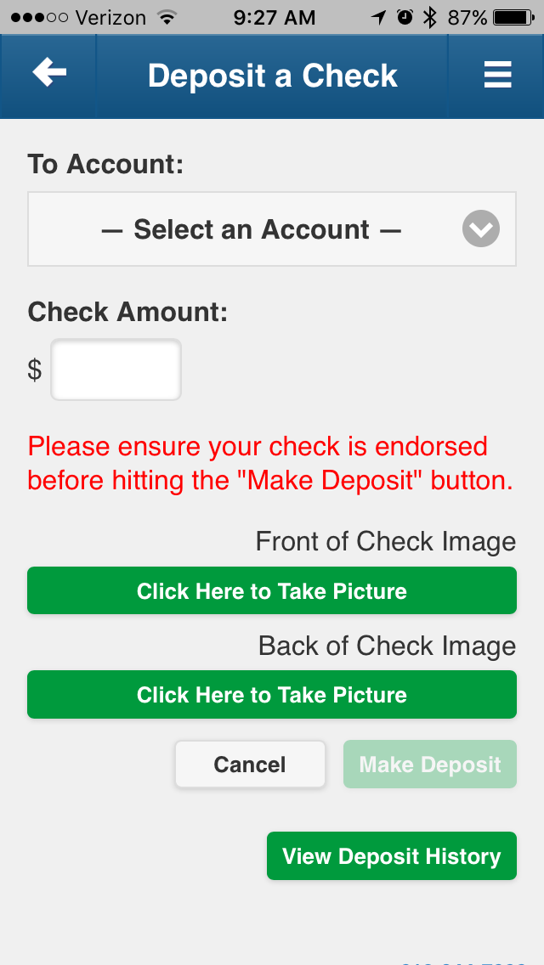
Remote Check Deposits
Take pictures of checks and deposit them remotely using your mobile device
View mobile deposit history

Slide 12
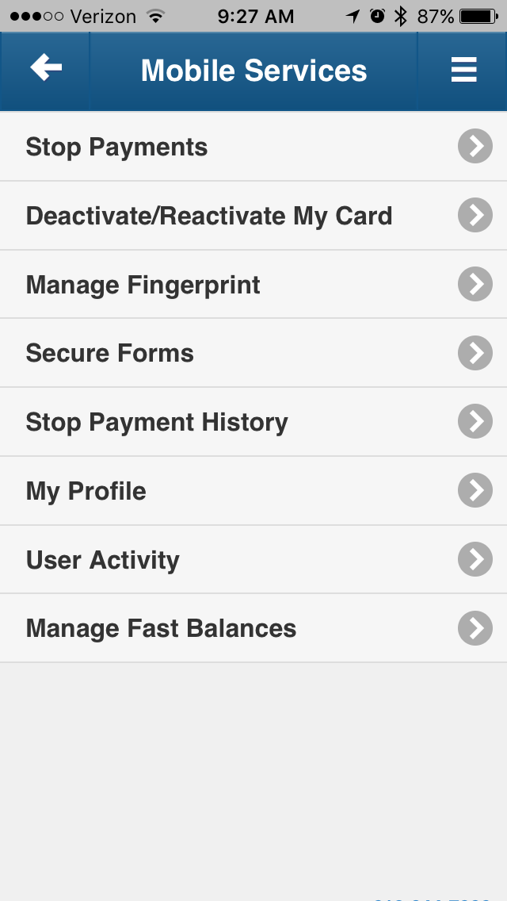
Mobile Services
Manage your account information from the Mobile Services
View user activity to monitor when your account has been accessed
Enable/disable Fast Balances from Mobile Services

Slide 13
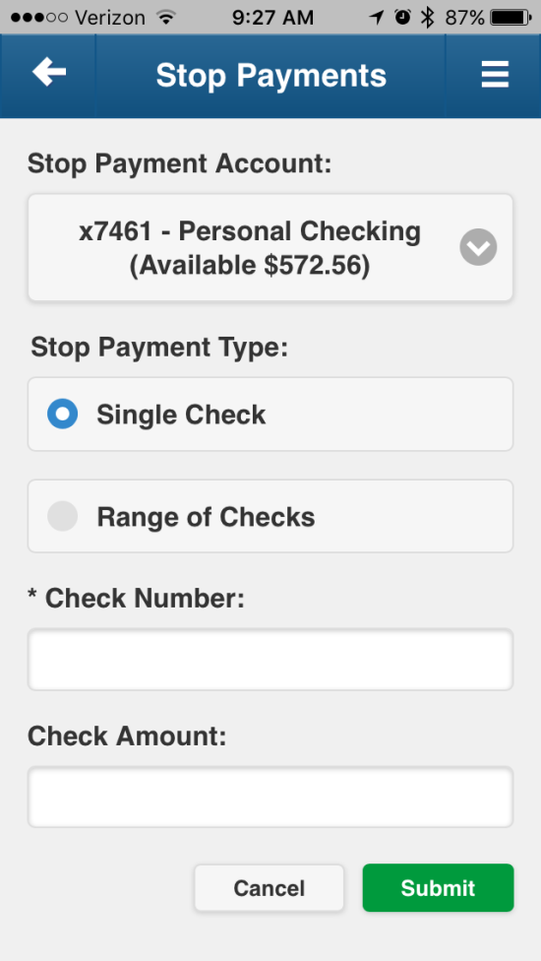
Stop Payments
Create stop payments for checks directly from your mobile device
Select a single check or a range of checks
Specify a reason for the stop payment
View stop payment history

Slide 14
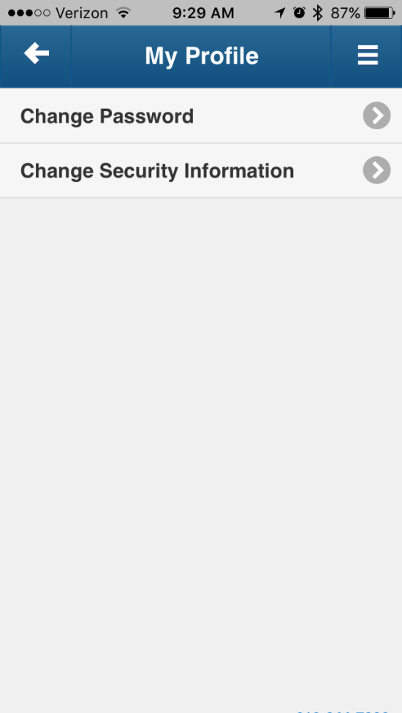
Manage My Profile
Manager your user and security info from the My Profile page
Any changes made to your mobile device are synced across your entire account

Slide 15
Thank you

