Slide 1

iBanking – User’s Experience

Slide 2
Agenda
Supported Browsers, Registration and Login
Navigation and Managing Accounts
Transferring Funds
Manage My Money
Banking Service Center

Slide 3
New User Registration

Slide 4
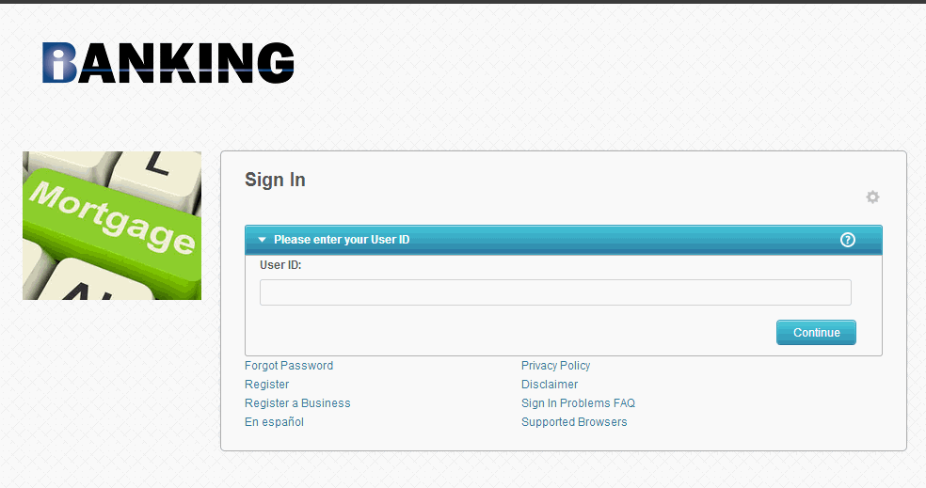

Supported Browsers Link
Login page contains several links to assist the users.
One informational link displays a list of supported browsers.

Slide 5
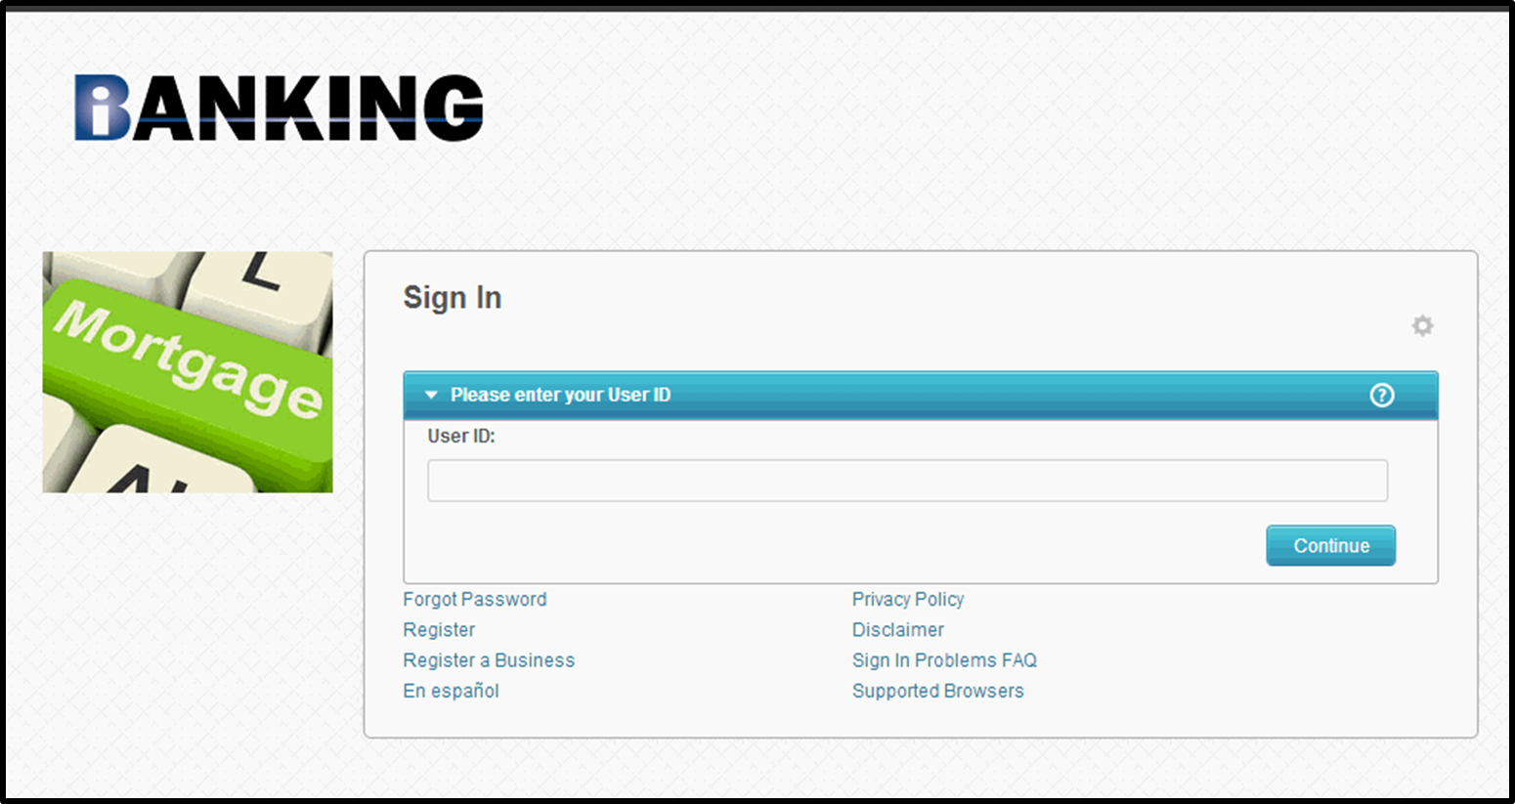

New User Registration

Slide 6
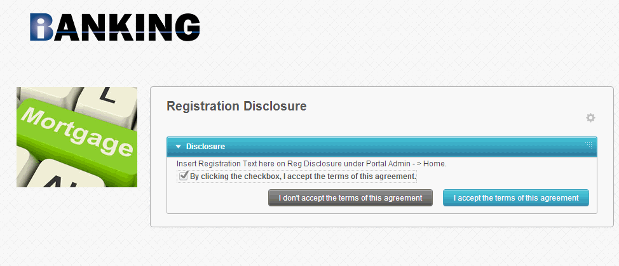
New User Registration: Disclosure
Users must acknowledge acceptance of the disclosure prior to being able to continue with registration

Slide 7
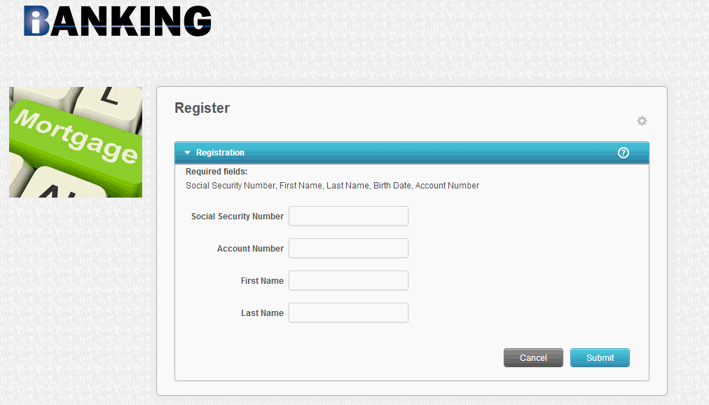

Slide 8

Forgot Password
Users can click on the recover password link to be prompted to change to a new password.
The user enters information here and clicks “Submit” to complete the verification and to reset his/her password

Slide 9
Login for Existing Users

Slide 10
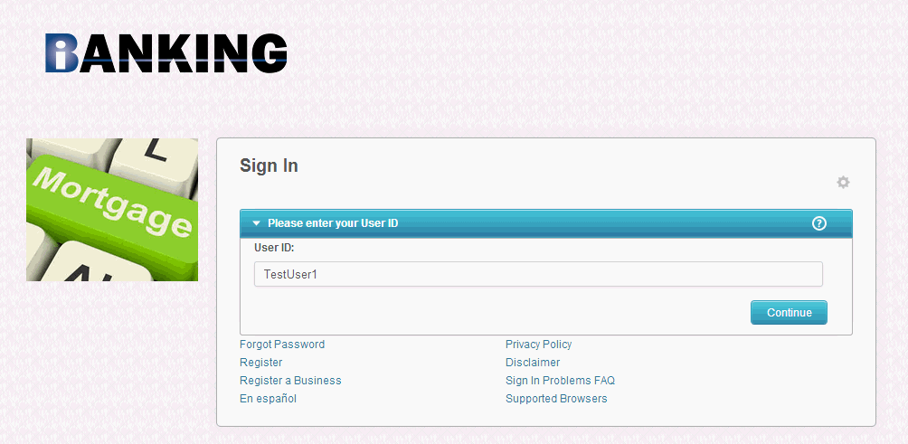
Log In
Users will enter User ID and click “Continue”

Slide 11
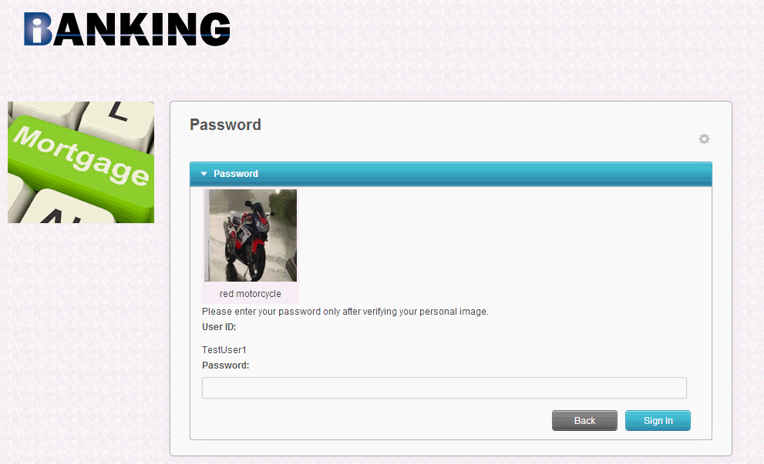
Password
User enters his/her password and clicks the “Sign In” button.

Slide 12
Navigation

Slide 13
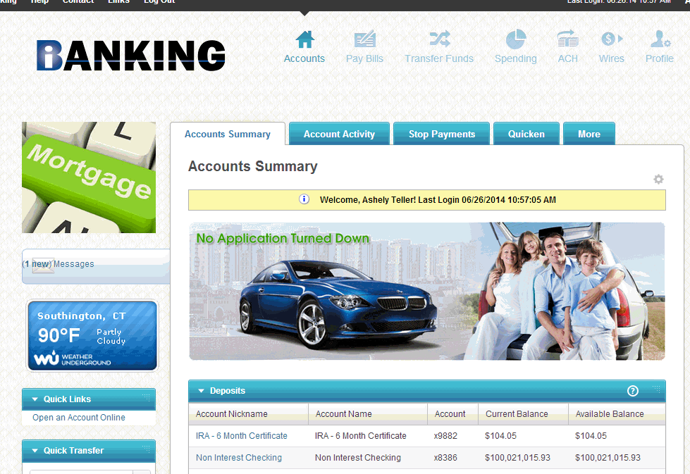

Main Dashboard
Tabs and sub-navigational links associated with each tab allow for ease in navigation.

Slide 14
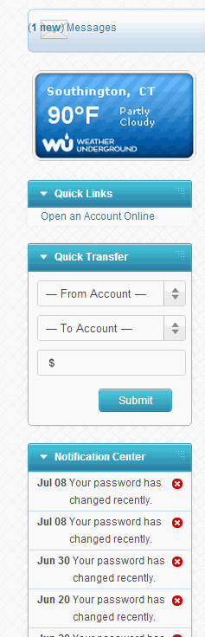
Main Dashboard: Left-Hand Navigation Bar
Right-hand or left navigation bar
Messages – takes users to secure message box.
Quick Transfer – immediate transfer (internal only) can be submitted directly from within navigation bar.
Notifications – displays notifications such as profile updates.

Slide 15
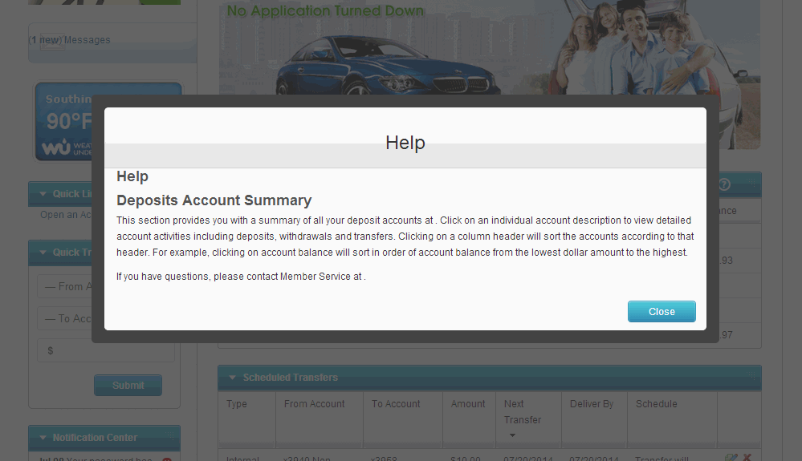

Help
Many sections in the system will have question mark icons in the header line.
To obtain Help information pertaining to the current screen, the users can click on the question mark.

Slide 16
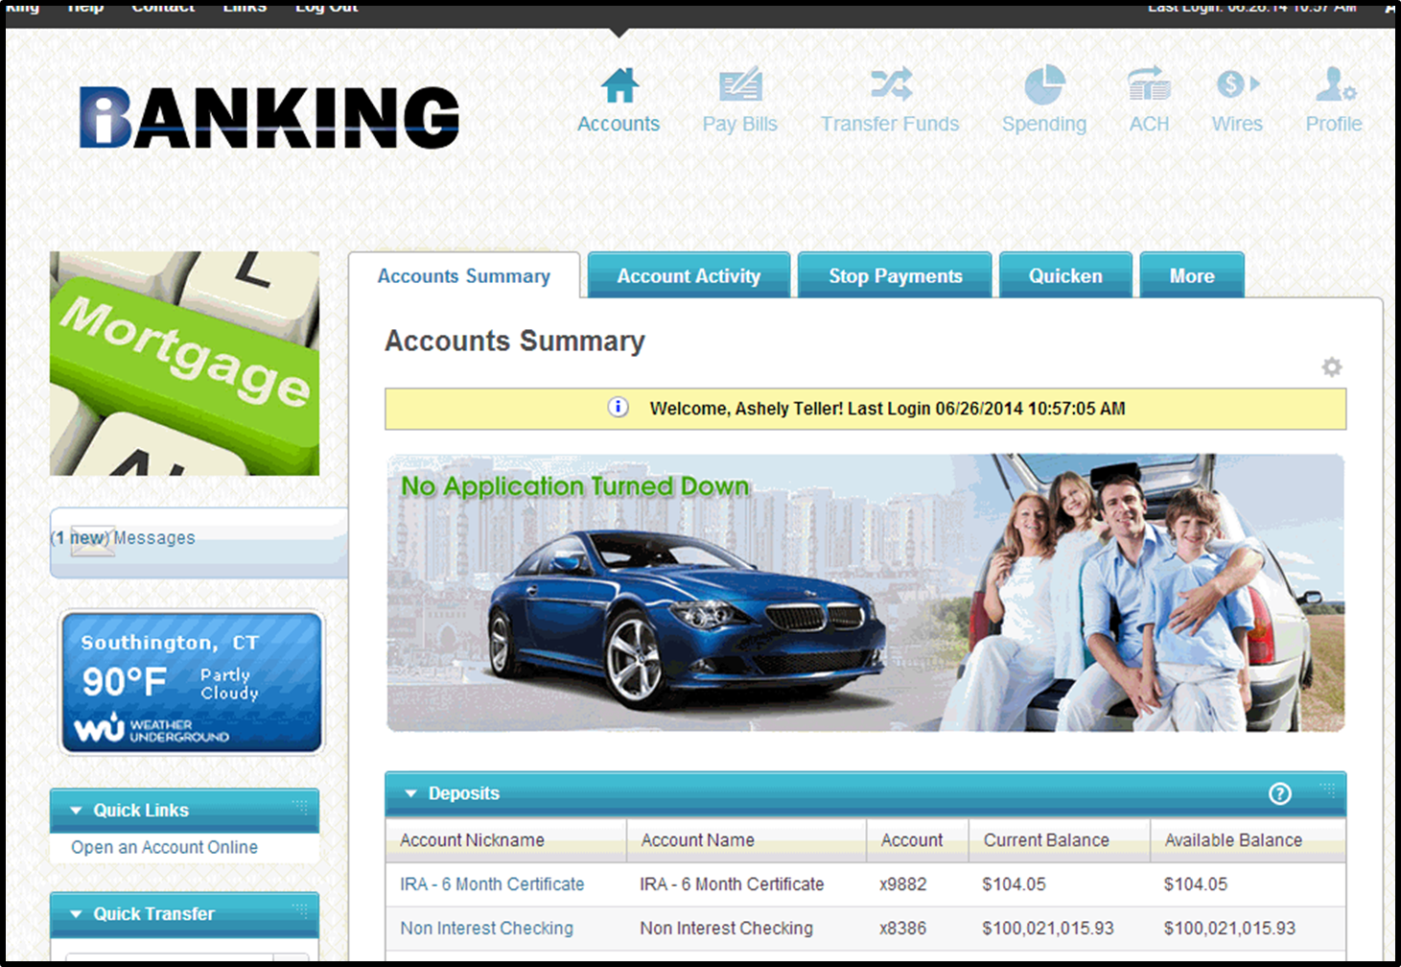
Display: User Preferences
The Customize Page link found in many sections in the application allows the users to set user preferences for what modules to display.
If the user clicks on the link in a module box appears.

Slide 17
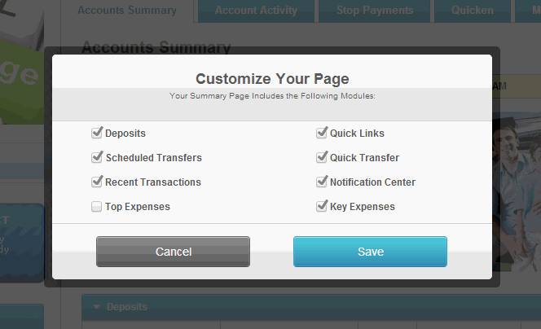
Display: User Preferences
User checks/unchecks the box next to each module to edit the display options. When finished, the users click “Save.”

Slide 18
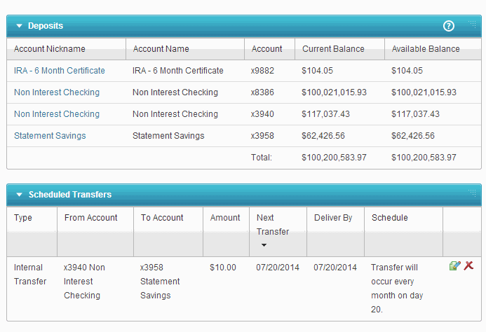


Display: User Preferences
Users can customize the page by repositioning some modules.
Modules with a triangle of white dots in the upper right-hand corner or the title bar can be dragged and dropped to another location on the screen.

Slide 19
Accounts

Slide 20
Accounts
When the users logs in, he/she is taken to the Account Summary tab of the Accounts module.
A summary of the user’s accounts, as well as recent and pending transactions are displayed.

Slide 21
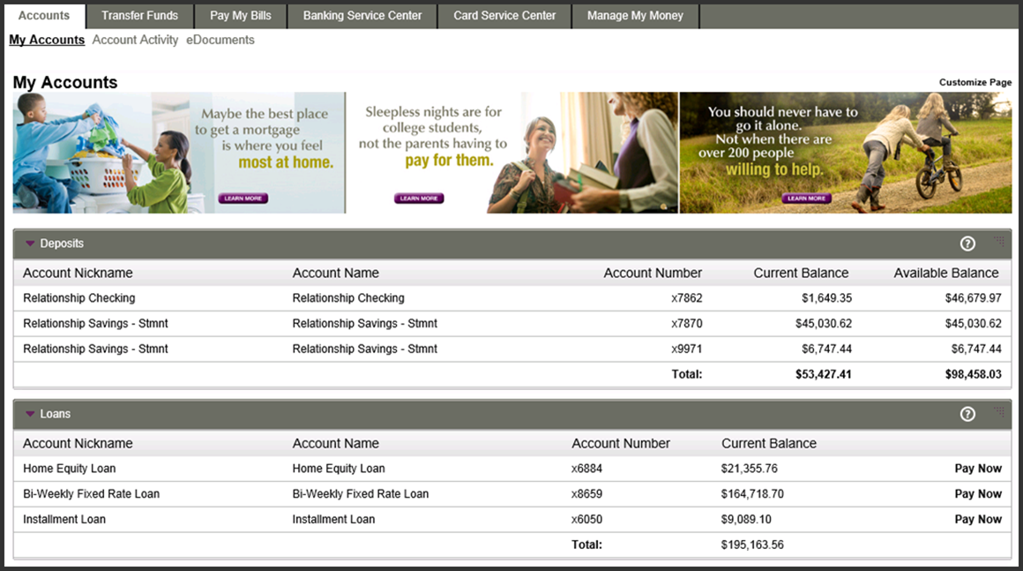
Loans – Pay Now
Pay Now link is available for loans.
Link takes users directly to the Transfer Funds where the user can select options to pay the loan.
User can view account activity and details by selecting account nickname.

Slide 22
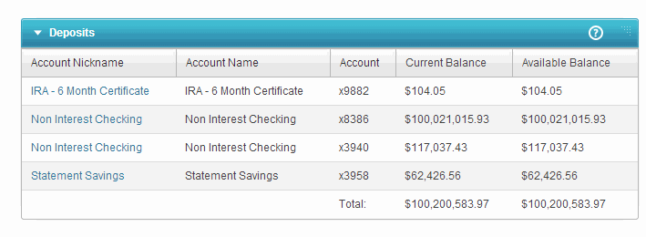
Account Activity
Users can search for transactions using preset options.
Account details appear to the right. Information displayed is dependent on the account type.

Slide 23
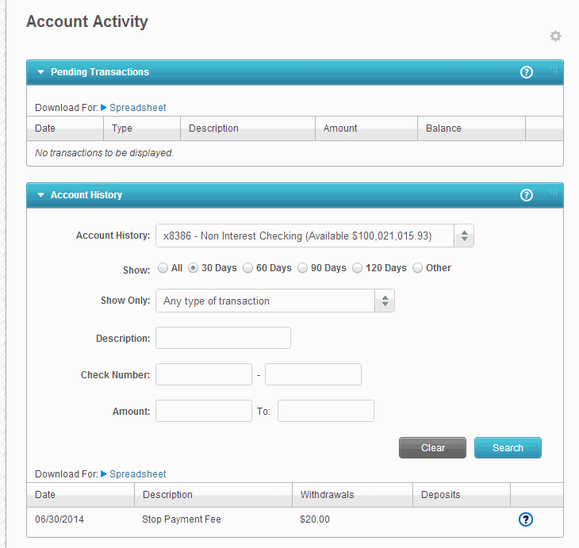
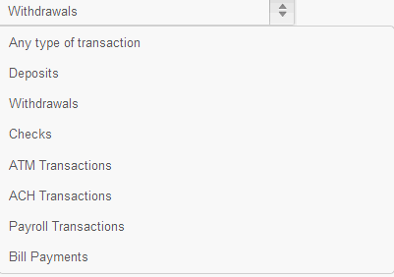

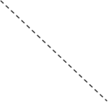
Account Activity: Account History
A user can use the Account History dropdown menu to navigate between accounts and filter by additional search criteria, as desired.
Resulting history displays at the bottom of the screen. Amount of history available is dependent on the core.

Slide 24
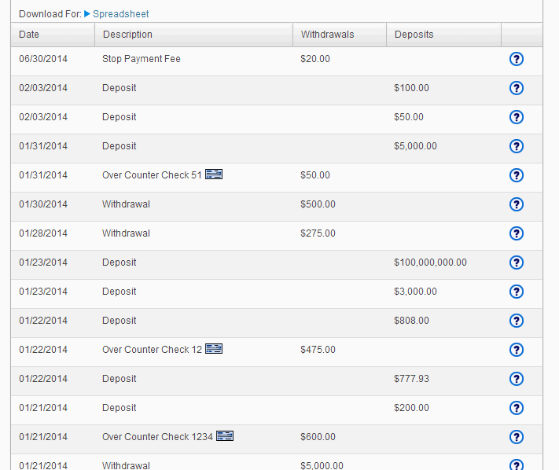

Account Activity: Account Details
Transaction link required

Slide 25
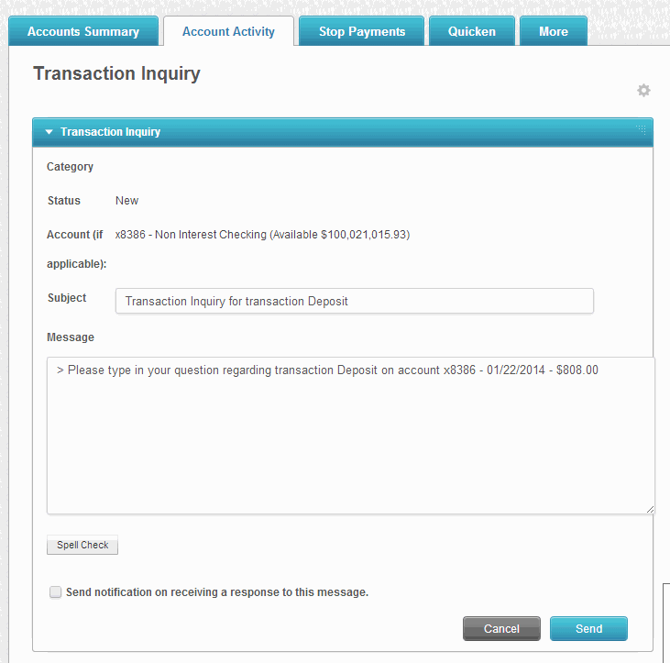

Slide 26
eDocuments
To retrieve eStatements the user selects “View Statements” or the year and clicks on magnifying glass following the desired month.
The eStatement will appear in a pop-up box. It can be viewed, printed and saved.

Slide 27
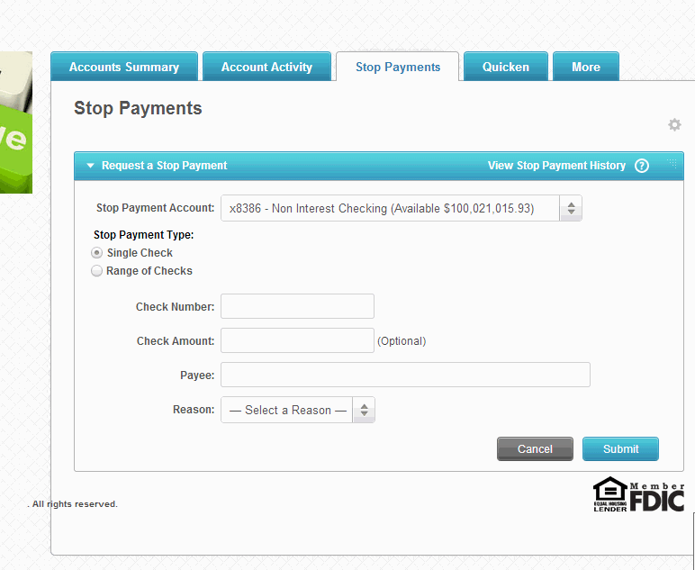
Stop Payments

Slide 28
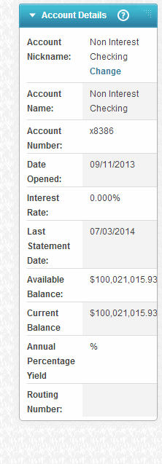
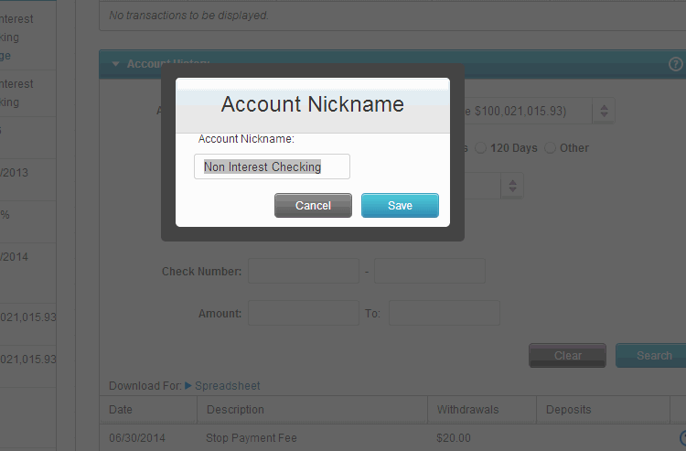


Change Account Nickname

Slide 29
Transfer Funds

Slide 30
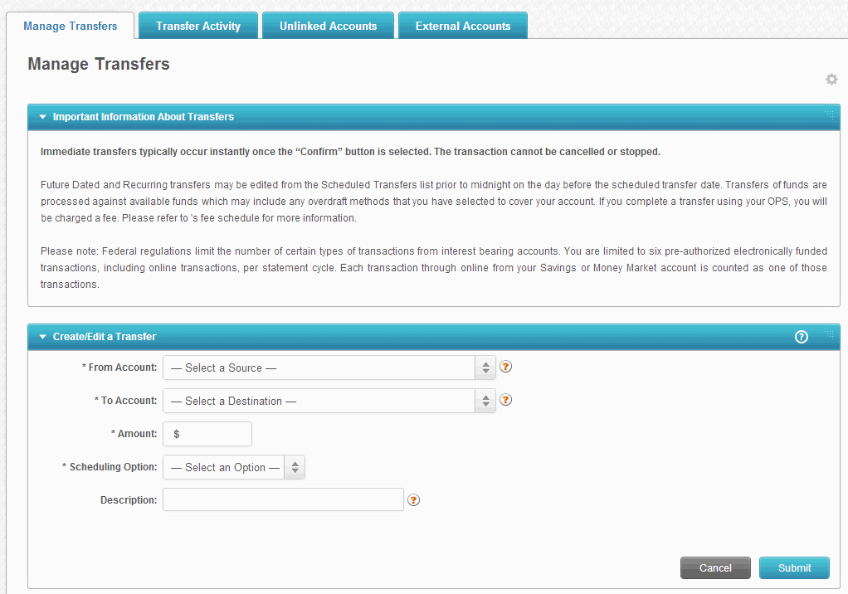
Manage Transfers
Users can create a new transfer or view/edit schedule transfers at Transfer Funds/Manage Transfers.
User chooses the “Form” and “To” accounts from the drop-down.

Slide 31
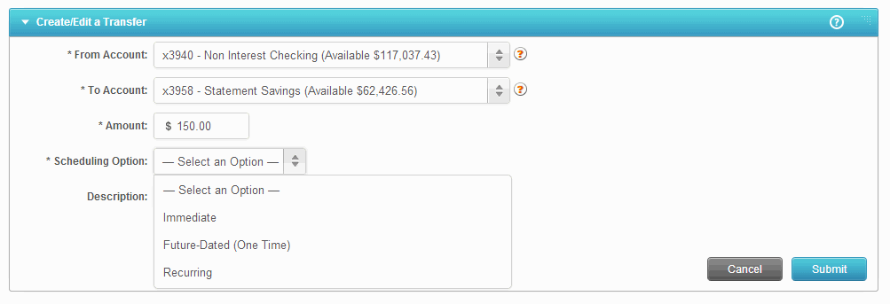
Manage Transfers
The user can choose from three transfer scheduling options:
Immediate – occurs once submitted
Future-dated – occurs on the scheduled date
Recurring – occurs per frequency selected

Slide 32
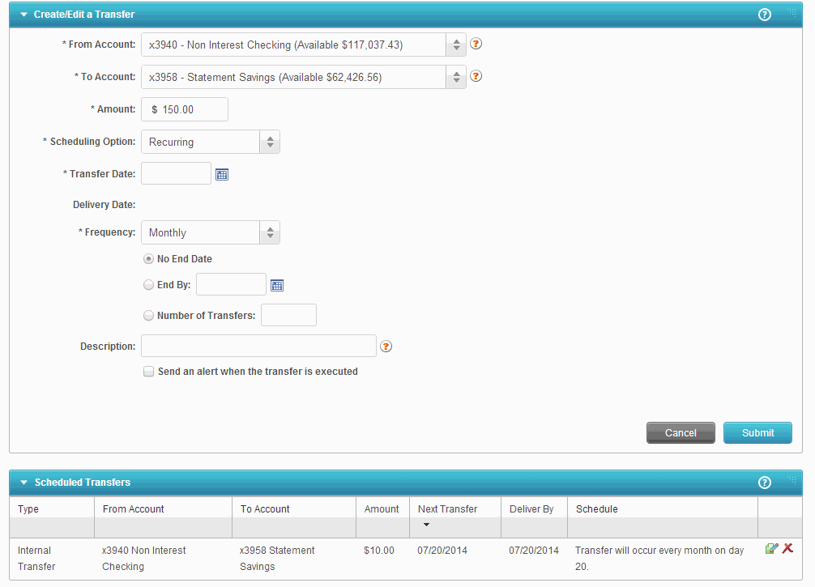
Manage Transfers
Recurring Transfers require additional information when at initial set-up: Transfer Date, Frequency and End Date or Number of Transfers.

Slide 33
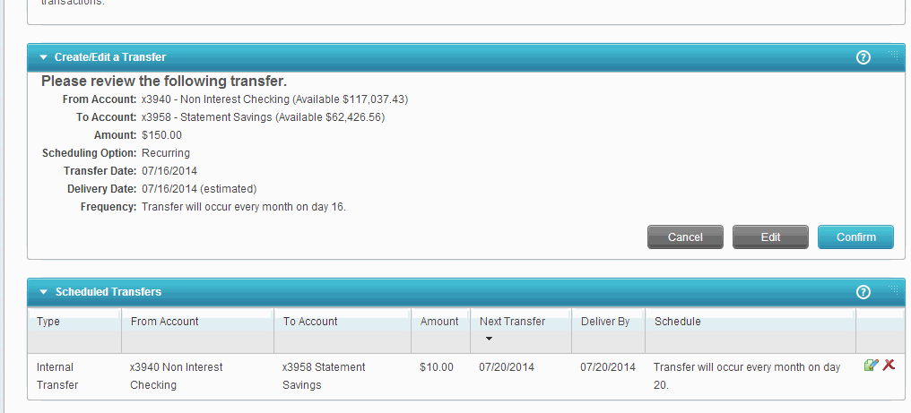
Manage Transfers

Slide 34
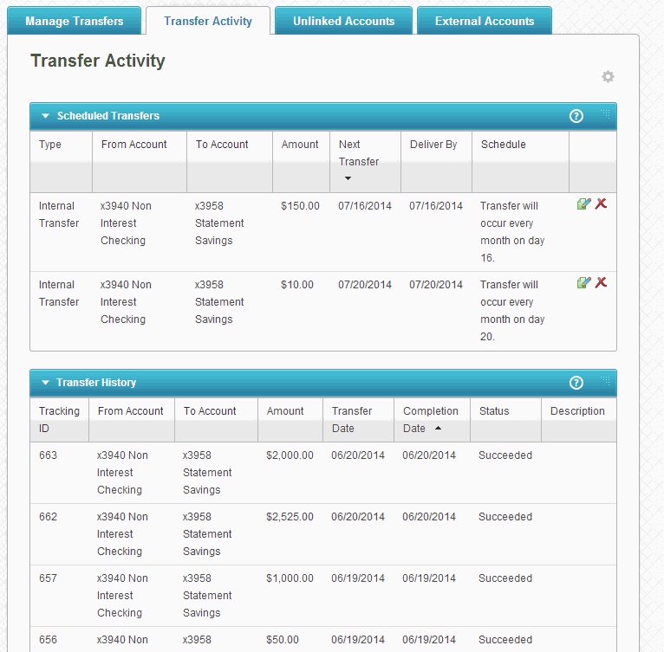
Transfer Activity
End users will be able to edit or delete Scheduled Transfers by accessing the icons.
Transfer History will display below Scheduled Transfers

Slide 35
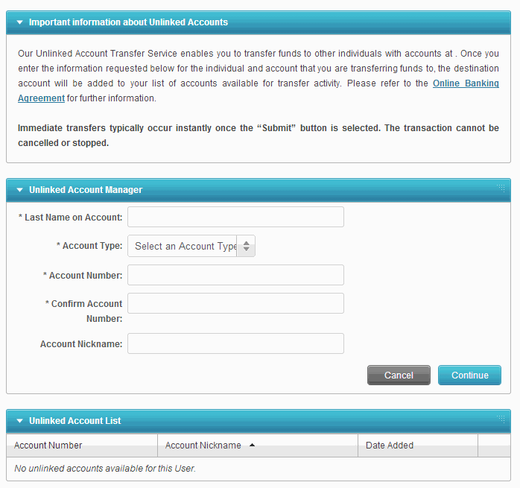
Person to Person

Slide 36
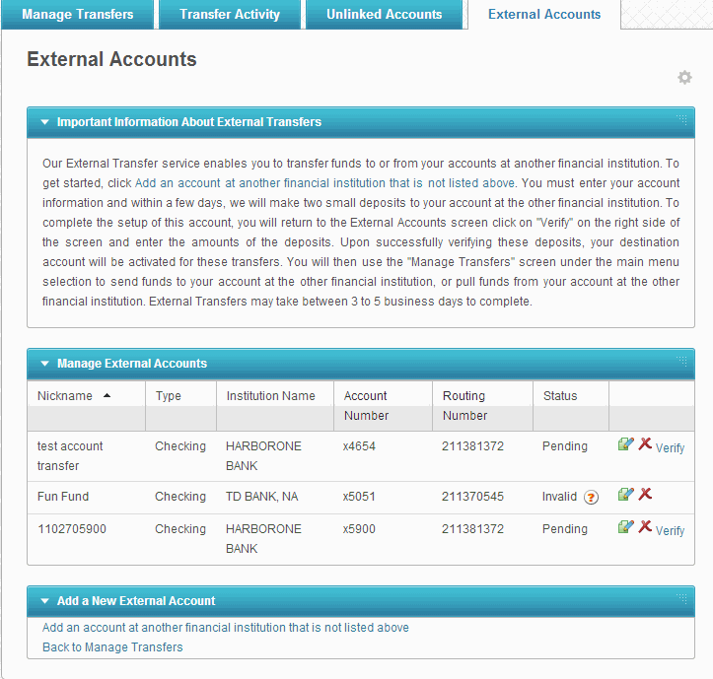
Bank to Bank

Slide 38
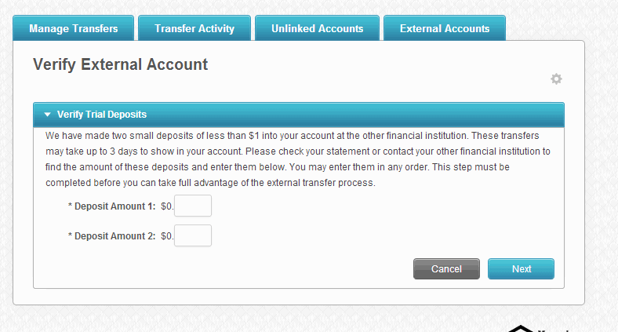

Slide 39
Bill Pay

Slide 40
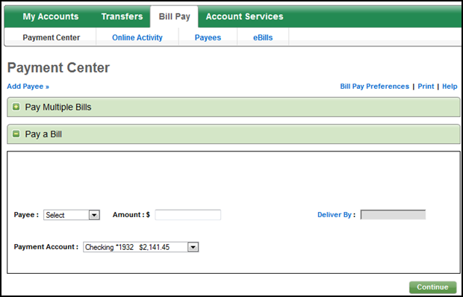
Payment Center
When selecting the “Pay Bills” tab, the user will arrive at the Payment Center.
Users have two options to make payments: Pay a Bill &Pay Multiple Bills
Users can switch between “Pay a Bill” and “Pay Multiple Bills” by clicking on the individual links.

Slide 41
Payment Center: Pay a Bill
“Pay a Bill” provides a check layout for bill payers who wish to make their payments one at a time.
Users will fill out the payment information and click on “Continue.”

Slide 42
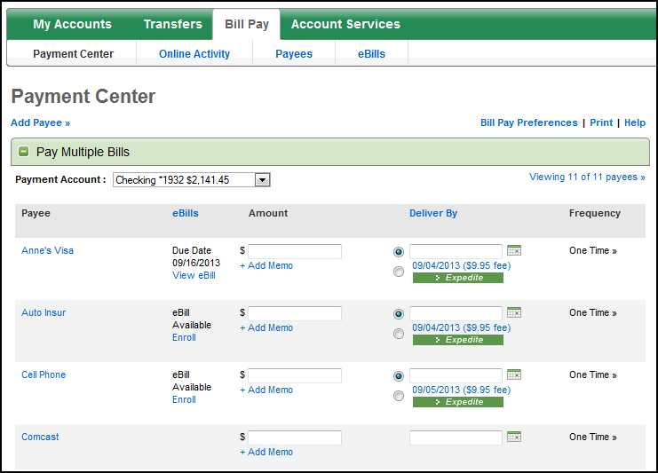
Payment Center: Pay Multiple Bills
“Pay Multiple Bills” allows users to pay several bills at one time.
Users will complete the Amount, Delivery By and Frequency fields for the payments they wish to make and click on “Continue.”

Slide 43
Payment Center: Add Memo
Users will have the ability to add a memo (note to self) to each of their payments.
This memo will not appear on the actual payment to the merchant, but will be viewable in Payment Activity.

Slide 44
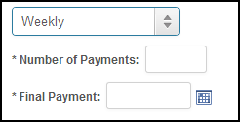
Payment Center: Payment Frequency Options
The default payment frequency is One Time, but users can select a new frequency from the dropdown if they would like to set up a recurring bill payment. After selecting a recurring frequency option, they will need to enter the number of payments or the final payment end date. Filling out one or the other will prefill the remaining field with the correct number of payments or end day.

Slide 45
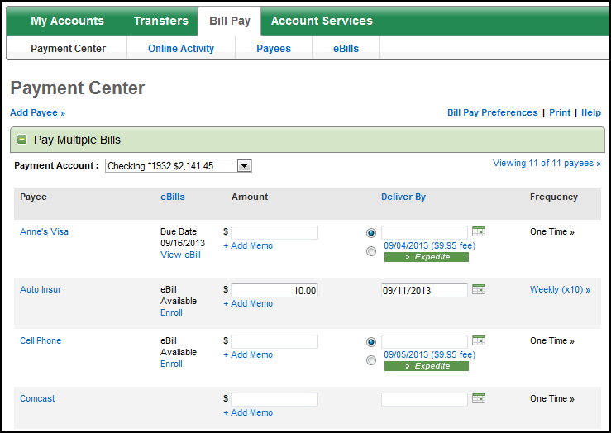
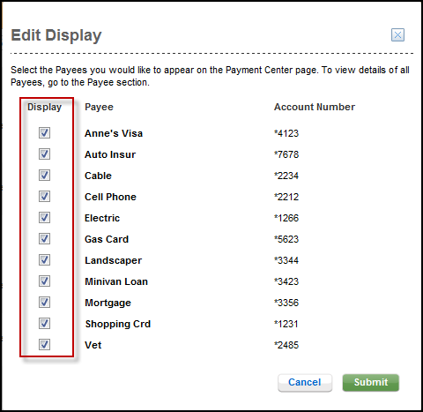
Payment Center: Edit Display

Slide 46
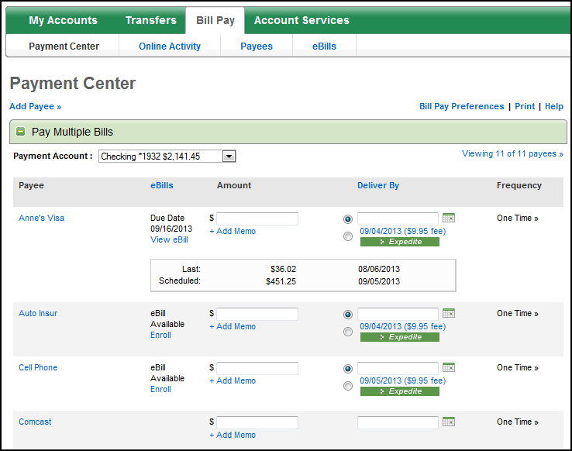
Payment Center: Last and Scheduled
The user can view the last and scheduled payments on each payee line.

Slide 47
Pay Multiple Bills: eBill
eBills have been integrated into the various bill payment screens to drive usage of the service. If a user has enrolled, eBill details will be displayed, including due date, minimum and total amount due.

Slide 48
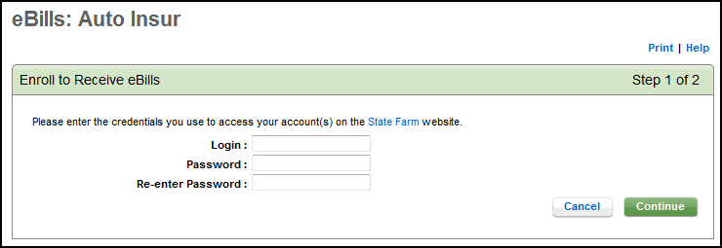
Pay Multiple Bills: eBills
To enroll a payee in eBills, users simply click on “Enroll” and enter the login credentials for the payee sight.
Note: users must first be enrolled for online account access at the payee site in order to utilize eBills. Users will be presented with an eBills disclosure the first time they enroll a payee for eBills.

Slide 49
Scheduling Payments Terminology
Delivery By Date: The date the payment should be received by the merchant.
Send On Date: The date the funds will be deducted from the user’s account.
Today Payments: Funds are deducted when the user submits the payment and logs out of the system.
Future Dated Payments: Funds will be deducted on the payments’ send on date.

Slide 50
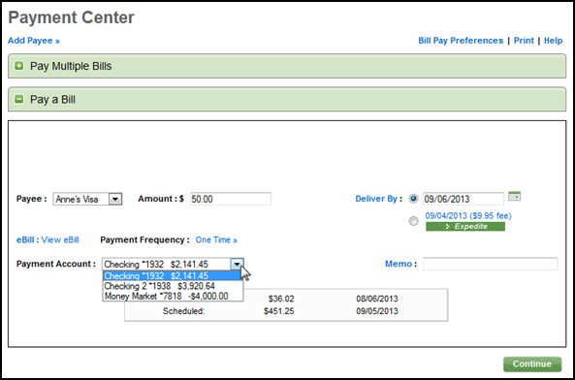
Scheduling a Payment

Slide 51
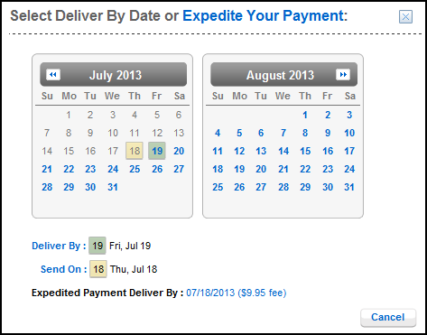
Scheduling a Payment: Electronic Payment
This is an example of a payee that accepts electronic payments. There is a 1-2 day delivery time for electronic, so the system will automatically put the Send On date back to the appropriate day to ensure the payment is delivered on time.

Slide 52
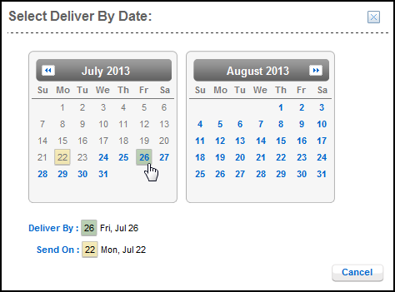
Scheduling a Payment: Check Payment
This is an example of a payee that accepts check payments. There is a 4-5 day delivery time for checks, so the system will automatically push the Send On date back to the appropriate day to ensure the payment is delivered on time.

Slide 53
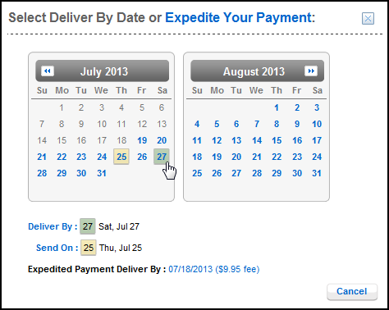
Scheduling a Payment: Weekends
This is an example of a user attempting to schedule a payment on a weekend. Please note, normally scheduled payments will not be sent on the weekend. The system will automatically push the Send On date back to the appropriate week day to ensure the payment is delivered on time.

Slide 54
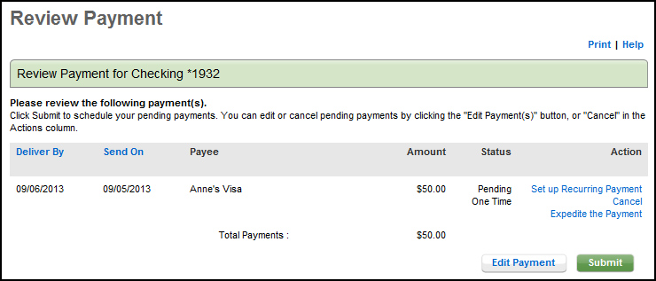
Scheduling a Payment: Review Payment
The user can make edits, set up a recurring payment, expedite the payment, or cancel the payment from the Review Payment screen.

Slide 55
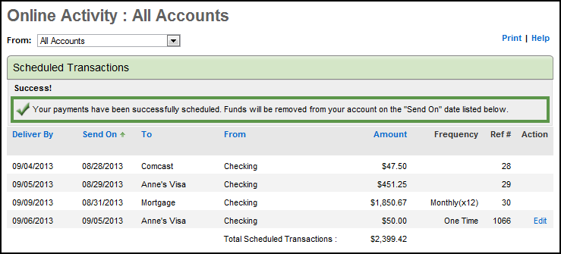
Scheduling a Payment: Confirmation
After clicking Submit, the user will see a confirmation at the top, and the payment will be displayed in Scheduled Transactions, under the Payment Activity sub-tab.

Slide 56
Expedited Payments
The Expedited Payment option will allow the user to make a payment to a merchant faster than other payment methods, for a fee.
Over 200 merchants offer the Expedited Payments option.
Each merchant will have their own unique cutoff time.
  If a user makes an expedited payment before the merchants cutoff time, the payment will reach the merchant the same day.
  If a user makes an expedited payment after the merchants cutoff time, the payment will reach the merchant the next business day.
Notes:
ACI combs through the merchant database constantly to ensure that if a merchant offers the expedite option, it will be displayed to the user.

Slide 57
Expedited Payments
If the Expedited Payment option is not available, the “Expedite” option will not display.

Slide 58
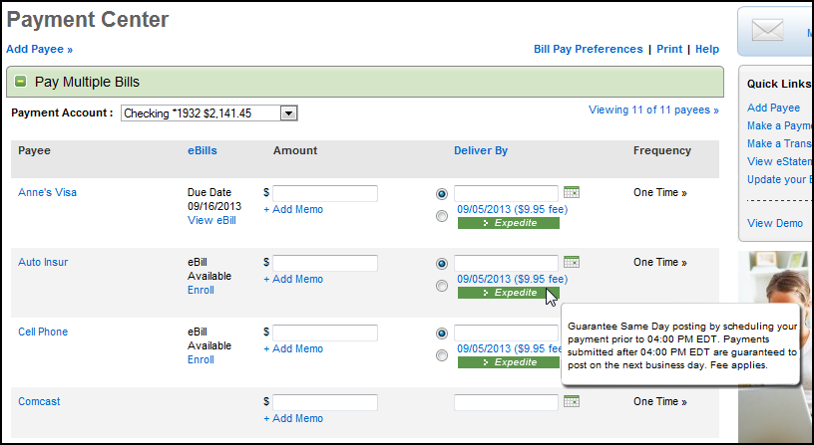
Expedited Payments
Hovering your mouse over the Expedite option will show additional information on scheduling. The cutoff time will be displayed in the user’s time zone.

Slide 59
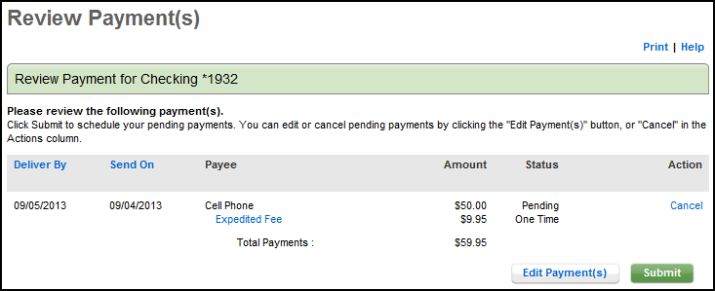
Expedited Payments
Before submitting an Expedited Payment, the user will see the payment amount and the payment fee. The total amount will be deducted from their account once they submit the payment.
Notes:
The expedited payment fee will be displayed separately on the review screen but the total payment PLUS the expedited payment fee amount will be immediately deducted after the payment has been submitted and the user has accepted the terms and conditions.

Slide 60
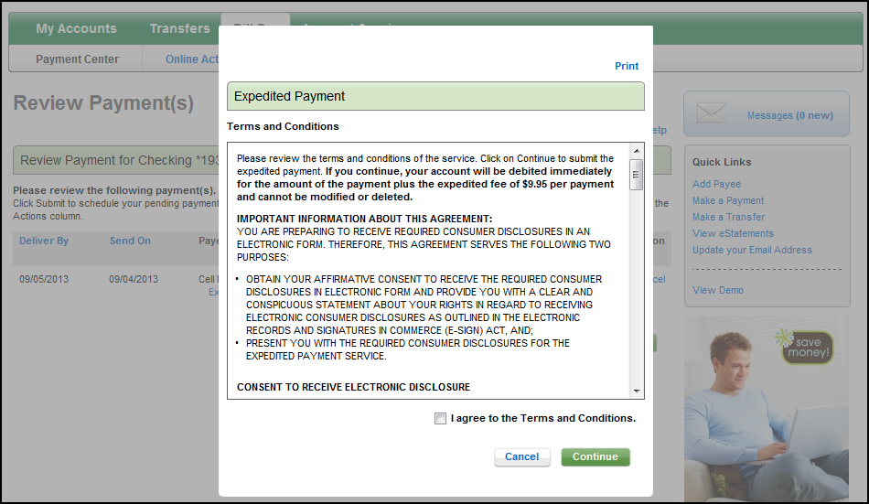
Expedited Payments
Each time a user schedules an expedited payment, they will be prompted to review the terms and conditions page.
When a user agrees to the terms and clicks “Continue,” the payment will be processed immediately.
Notes:
The system will not move forward and the payment will not be processed until the user agrees to the Terms and Conditions.

Slide 61
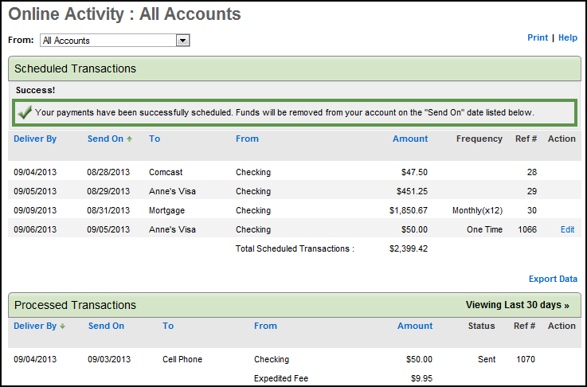
Scheduling a Payment: Confirmation
After clicking Submit, the user will see a confirmation at the top, and the payment will be displayed in Processed Transactions, under the Payment Activity sub-tab.

Slide 62
Payment Activity

Slide 63
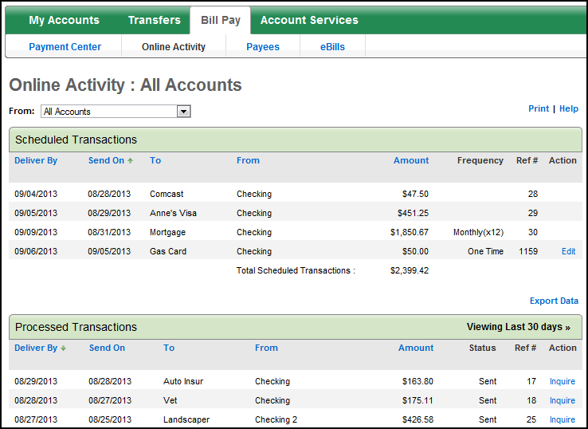
Payment Activity
users will be able to view and edit all of their scheduled and processed transactions when they click on the “Payment Activity” tab.

Slide 64
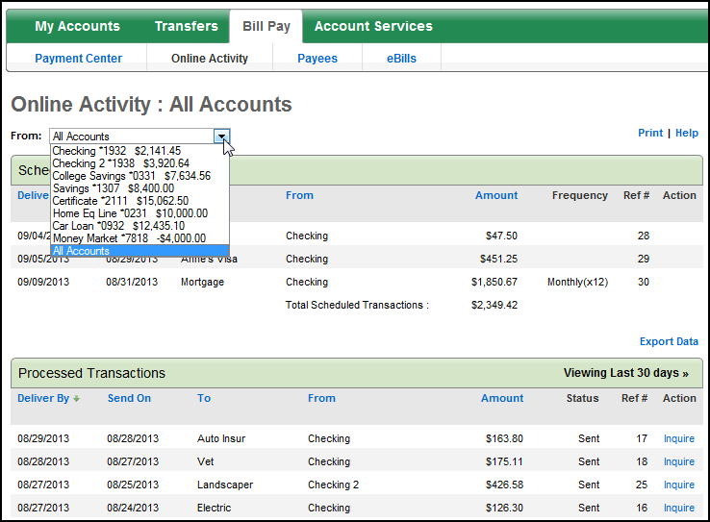
Payment Activity
Search options, including accounts, delivery by dates, or payee names will be available at the top, should the user wish to use them.

Slide 65
Payment Activity: Scheduled Transactions
users will be able to view a total of all of their scheduled transactions.

Slide 66
Payment Activity: Scheduled Transactions
users can edit a scheduled payment by clicking on the Edit icon. They will then be directed to the Change Scheduled Payment screen.

Slide 67
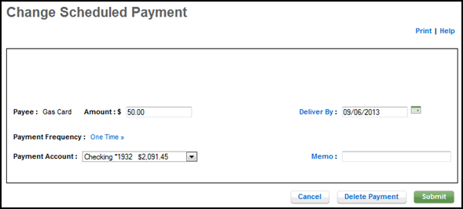
Payment Activity: Scheduled Transactions
users will have the option to edit the payment or delete it completely.

Slide 68
Payment Activity: Processed Payments
users will be able to view all of their processed payments and can submit a payment inquiry for a particular payment by clicking on the “Inquire” link.

Slide 69


Payment Activity: Payment Inquiry
Depending on what the user chooses in the inquiry details dropdown, the inquiry will be sent either directly to ACI Payment Ops or to the iBanking Admin Message Center.
Notes:
Payee Details and Payment Information will also be displayed on the Payment Inquiry screen.

Slide 70

Payment Activity: Payment Inquiry

Slide 71
Payment Guarantee

Slide 72
Payment Guarantee
If a properly scheduled payment is not received and posted on time by the payee, we will attempt to have any late fees or assessed finance charges removed. (Finance charges are calculated based on your payment amount rather than your entire balance.) If the payee is unwilling or unable to remove them, we will pay the fees and finance charges directly to the payee. In addition, we will attempt to have your account noted appropriately to ensure that the situation does not negatively impact your credit rating. (NOTE: Please see the Electronic Funds Transfer Disclosure for important information on the limitations of reimbursable fees and finance charges.)

Slide 73


Payment Guarantee: Excluded Merchants
Allowed, Not Covered:
Payments to payees located in the Armed Forces postal codes
Payments to settle securities transactions
Payments to payoff “special financing”
Unprocessed payments due to debit failures
Not Allowed, Not Covered:
Tax entities
Collection agencies
Court-ordered payments such as alimony, child support, speeding tickets, etc.
Non-US Payees
Terrorists
Notes:
Certain types of Payees are prohibited in our Bill Pay system. They are not allowed and not covered by our Payment Guarantee. They display in the Not Allowed, Not Covered column.
Tax Entities, Collection Agencies and Court Ordered payments – not covered typically because the late fees and penalties could occur from previous missed payments, (even years of missed payments) and result in large fines/penalties and these entities are unwilling to negotiate or waive when late fees/penalties are assessed. ACI does not process payments for Non-US Payees and does not cover Non-US Payees in their Payment Guarantee. ACI check OFAC lists when Payees are added to our database and runs OFAC again as it is processing payments.
There are some excluded merchants that we allow to be paid through this service but are not covered under the Payment Guarantee. They display in the Allowed, Not Covered column. They include:
Payments to payees located in the Armed Forces postal codes (because we cannot control delivery times).
Payments to Payments to settle securities transactions (because often security transactions have 3 day rescission periods which we cannot accommodate).
Payments to payoff “special financing” because if a payment is made late anytime in that financing time period, it will result in all the interest being applied at the end of the term. (ACI may not have even be involved in the previous payments but the late fees will still apply and the company will not negotiate)
If a payment fails for NSF (because the user does not have the money in their account) we will not cover the late fees or penalties.

Slide 74
Payment Guarantee: Terms & Conditions
Payment scheduled to “deliver by” on or prior to due date.
Payment not made to an excluded merchant.
Information supplied by the user is correct.
Adequate funds are available in user’s account.

Slide 75
Payees

Slide 76

Payees
users will be able to view their entire payee list by clicking on the Payees sub-tab. There is no limit to the number of payees that can be added. They can edit, pay a bill or delete it from this screen.
Notes:
Each time a payee is added to the system, it will appear in the All Payees list in alphabetical order.

Slide 77

Payees: Edit Payee
users will have the ability to update payees’ addresses and account numbers online.

Slide 78
Payees
Clicking the payee name will open the payee details.

Slide 79

Payees: Payee Details
users will be able to view Payee Details, such as address and account number, and view scheduled payments and processed payments.

Slide 80
Payees: Payee Details
The user will be able to see the payment delivery method (electronic or check) based on the number of days the payment will take to deliver.
1-2 Days: Electronic payment
4-5 Days: Check payment

Slide 81
Payees: Add Process to ACI Merchant Database
AutoMatch
    If the information matches what is in the ACI merchant database exactly, it is linked immediately.
“Shake N Bake”
    Merchant services representative (from ACI) tries to link possible matches.
Manual Verification
    A Merchant Services Representative adds the new payee to our Merchant Database.
Notes:
A manual verification can take up to three business days.

Slide 82
Payees: Delivery Methods and Times
Payment Delivery methods or paths are determined when the payee is added or linked in our merchant database.
When an Electronic Payment Path is established:
    Payment is delivered in 1-2 Business days
    Electronic Methods include ACH, UDB and RPPS
When a Check Payment Path is established:
    Payment is delivered in 4-5 Business days
    ACI Checks are printed and mailed first class mail

Slide 83

Payees: Add Payee
The user will click the “Add Payee” links to add a new payee.

Slide 84

Payees: Adding Another Business
users can choose whether they would like to add a business or an individual as a payee by moving the radio button to the appropriate option.

Slide 85

Payees: Adding Another Business
users can enter the full name of the payee in the business name

Slide 86
Payees: Adding Another Business
Once the user completes the Add Payee form, they will hit Submit. The payee will automatically be added to the Bill Pay system.

Slide 87
eBills

Slide 88
eBills
eBills allow users to receive electronic summaries of their bills online, and pay those bills within the online service.
An user must have an “online relationship” with the participating Biller to enroll in eBills (i.e. an account).

Slide 89

eBills
The eBills section includes unpaid eBills, payees enrolled in eBills, and payees eligible for eBills.

Slide 90
eBills: Unpaid eBills
users will be able to view the current due date, total due, and minimum due on all of their unpaid eBills.
users also have the ability to pay, file or visit the payee website for additional details.

Slide 91
eBills: Payees Enrolled in eBills
users can view payees enrolled in eBills here. They can choose to visit the payee website, update their eBill credentials, or unenroll.
Notes:
Clicking on the “View” link will take them to the 3rd party site of that Biller or Payee, where they can look up payment information.

Slide 92
eBills: Payees Eligible for eBills
If a user has not enrolled in eBills for one or more payees, they will be listed under the “Payees Eligible for eBills” section.

Slide 93
Manage My Money

Slide 94

Spending
Top of screen
Your institution offers financial tracking options that allow the users to monitor cash flow, set savings goals and create budgets under the Spending icon.
Graphs of Top Expenses and Top Balances appear in the left-hand bar when sufficient data is available.

Slide 95

Spending: Overview
Bottom of Screen

Slide 96

Spending: Edit Accounts
users can edit the list of accounts they wish to track and time period.
Time period defaults to the current month and also displays data for 2 previous months and
3 -month average
Notes:
users can add or edit list of accounts he/she wishes to track.

Slide 97

Selecting Accounts
users can select the accounts (up to 10) to view and track.
User selects “Update” to accept changes or “Cancel” to return to Overview screen without changes.
Notes:
The Select Accounts pop up window becomes visible.
Up to 10 accounts may be added.

Slide 98

Spending: Transaction Details
Each month, the user will start off with the prior month’s ending balance.
As the month progresses, Transaction Details display in the link for each account for the month selected.
Notes:
Monthly account activity can be obtained by clicking on the account balance for the month.
This monthly account activity will be noted on the Income Statement, as either Income or Expense.

Slide 99


Spending: Transaction Details
Categories are systematically applied to transactions, but users will be able to manually select categories for transactions to represent an accurate picture of spending.
Notes:
userss will be able to manually select categories for transactions that come through as “uncategorized” and then may choose the option to apply to all future matching transactions. Note: to be able to apply category in the future, the transaction description must be an exact match.

Slide 100

Spending: Transaction Details
When editing a category, users may choose the option to apply to all future matching transactions. If selected, all future transactions with same description would be systematically assigned to that category.
Notes:
userss will be able to manually select categories for transactions that come through as “uncategorized” and then may choose the option to apply to all future matching transactions. Note: to be able to apply category in the future, the transaction description must be an exact match.

Slide 101


Spending: Transaction Details
User can also split a transaction across more than 1 category, as well as add internal notes.
User enters the amount to be designated to a different category and selects the appropriate category from the drop-down.
Transaction may be split into additional categories, if needed.

Slide 102


Spending: Income Statement
The Transaction Details are totaled each month for all accounts and then listed under the Income Statement as either Income or Expenses.
users can view transaction details for a specific line item.
Notes:
Monthly account activity can be obtained by clicking on the account balance for the month.
This monthly account activity will be noted on the Income Statement, as either Income or Expense.
The users can view transaction details for a specific line item.

Slide 103

Spending: Income Statement
Income – Expenses = Net Income
Cash flow can also be tracked.
Notes:
In the Cash Flow section of the Spending/Budgeting feature, the users will be able to view his/her Net Income for three months individually and then as a three month average.

Slide 104

Spending: Savings Goals
users can set up savings goals by selecting “Savings Goals” tab or link in Savings Goals bar.
Up to 2 goals can display on the Savings Goals bar.

Slide 105

Spending: Budget
users can set up and edit budget amounts for various expenses and incomes by selecting the “Budget” tab or “Manage” link on the Budget bar.
Standard categories are provided by the system but users can also add categories for personal tracking purposes.

Slide 106

Spending: Budget Sample
When a user first comes to the Budget page the system will display the current month’s budget information.
Users can also select a previous month to obtain historical budget information.
users enters monthly budget goals. Difference between actual and budget displays.

Slide 107

Spending: Budget Categories
To add a personal category, the user selects the type (expense or income), enters name and description. and clicks “Add” and “Done” buttons.

Slide 108
Banking Service Center

Slide 109

Banking Service Center

Slide 110

Account Services

Slide 111

Alerts
An users can subscribe to a variety of notification alerts which can be sent to one or more of the user’s email addresses.
At the top of the Alerts page important information about alerts is disclosed.
To set up the alerts, the users selects the Alerts option under the More sub-tab under the Profile icon.

Slide 112

Alerts
users selects the desired alert from the alert list and selects the “Add Subscription” button.

Slide 113


Alerts
users sets the parameters for the alert and selects “Submit”.
Once an alert subscription is added, it will be listed under the Current Alerts section.
Alert History is viewable will display at the bottom of the page when alerts have been sent.

Slide 114
Online Security

Slide 115

Change User ID

Slide 116

Profile Information

Slide 117

Email Address

Slide 118

Secure Message Center

Slide 119


Compose New Message

Slide 120

Confirmation

Slide 121

Card Service Center

Slide 122

Log Out
To log out, users should use the link in the black bar at the top of the screen. Link is available from any page in online banking.

Slide 123

Thank you

